Slide 1
My Applications Interactive Notebook
Name
Class AEMAA 1
Teacher Mrs Keen
Term 1 Semester 1
1

Slide 2
Create your own front page
It needs to contain the following –
My applications interactive notebook
Name
Class
Teachers Name
Semester 1 Term 1
Page number 1

Slide 3
Contents
Glossary or Formula Page
Page
Date
Description
2
3

Slide 4
Tasks
24
7
30
Essential Question
Questions
Notes
Summary
4
5

Slide 5
24
7
30
Date
Topic
Percentages
EQ – What are common uses of percentage?

Slide 6
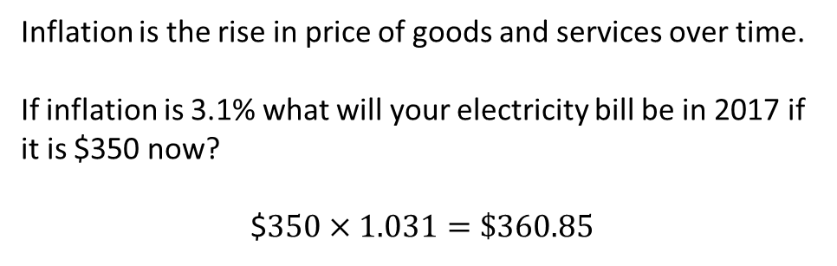
24
7
30
Date
Topic
Percentages
EQ – What are common uses of percentage?
Inflation
Inflation is the rise in price of goods and services over time.
If inflation is 3.1% what will your electricity bill be in 2017 if it is $350 now?
$$350×1.031=\$360.85$

Slide 7
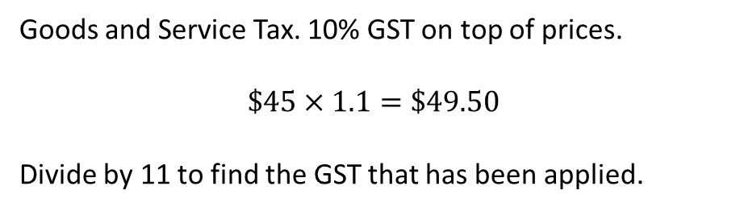
24
7
30
Date
Topic
Percentages
EQ – What are common uses of percentage?
Inflation
Inflation is the rise in price of goods and services over time.
If inflation is 3.1% what will your electricity bill be in 2017 if it is $350 now?
$$350×1.031=\$360.85$
GST
Goods and Service Tax. 10% GST on top of prices.
$$\$45×1.1=\$49.50$$
Divide by 11 to find the GST that has been applied.

Slide 8
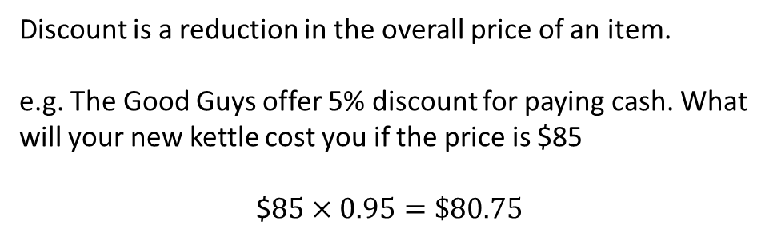
24
7
30
Date
Topic
Percentages
EQ – What are common uses of percentage?
Discounts
Discount is a reduction in the overall price of an item.
e.g. The Good Guys offer 5% discount for paying cash. What will your new kettle cost you if the price is $85
$$85×0.95=\$80.75$

Slide 9
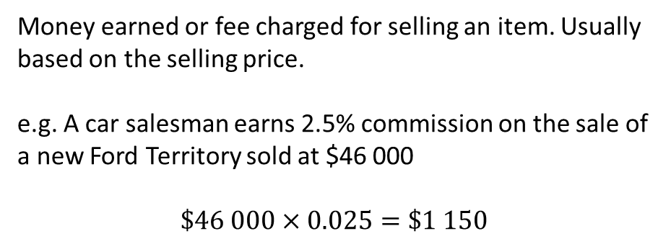
24
7
30
Date
Topic
Percentages
EQ – What are common uses of percentage?
Discounts
Discount is a reduction in the overall price of an item.
e.g. The Good Guys offer 5% discount for paying cash. What will your new kettle cost you if the price is $85
$$85×0.95=\$80.75$
Commission
Money earned or fee charged for selling an item. Usually based on the selling price.
e.g. A car salesman earns 2.5% commission on the sale of a new Ford Territory sold at $46 000
$\$46 000×0.025=\$1 150$

Slide 10
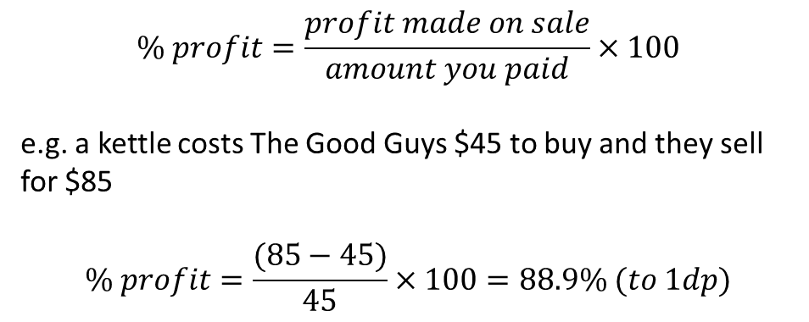
24
7
30
Date
Topic
Percentages
EQ – What are common uses of percentage?
Profit and Loss
$$\% profit=\frac{profit made on sale}{amount you paid}×100$$
e.g. a kettle costs The Good Guys $45 to buy and they sell for $85
$$\% profit=\frac{(85−45)}{45}×100=88.9\% (to 1dp)$$

Slide 11
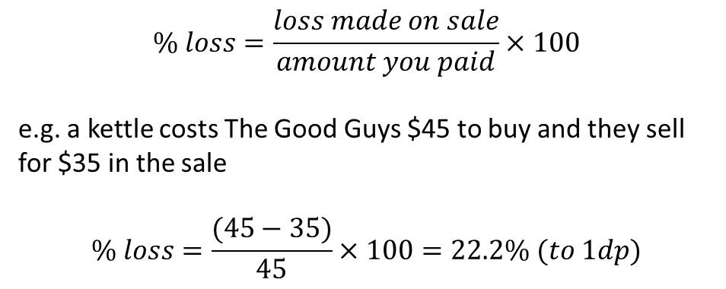
24
7
30
Date
Topic
Percentages
EQ – What are common uses of percentage?
Profit and Loss
$$\% profit=\frac{profit made on sale}{amount you paid}×100$$
e.g. a kettle costs The Good Guys $45 to buy and they sell for $85
$$\% profit=\frac{(85−45)}{45}×100=88.9\% (to 1dp)$$
$$\% loss=\frac{loss made on sale}{amount you paid}×100$$
e.g. a kettle costs The Good Guys $45 to buy and they sell for $35 in the sale
$$\% loss=\frac{(45−35)}{45}×100=22.2\% (to 1dp)$$

Slide 12
Task
Complete the questions on pages 31 to 36.
Questions 14 to 25 on page 36 may be completed using your classpad.
Then/Homework:
Complete the questions set for you on percentages and inflation on Mathspace.

Slide 13
Notes Review
24, 7 ,30
Date
Title
Essential question
Notes complete
Notes complete with colour and diagrams
Questions completed
Contents page filled in
Formula page filled in

Slide 14
Homework
Review your notes and write a summary answering the essential question.

